Slide 1
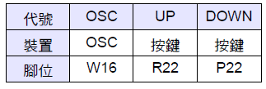
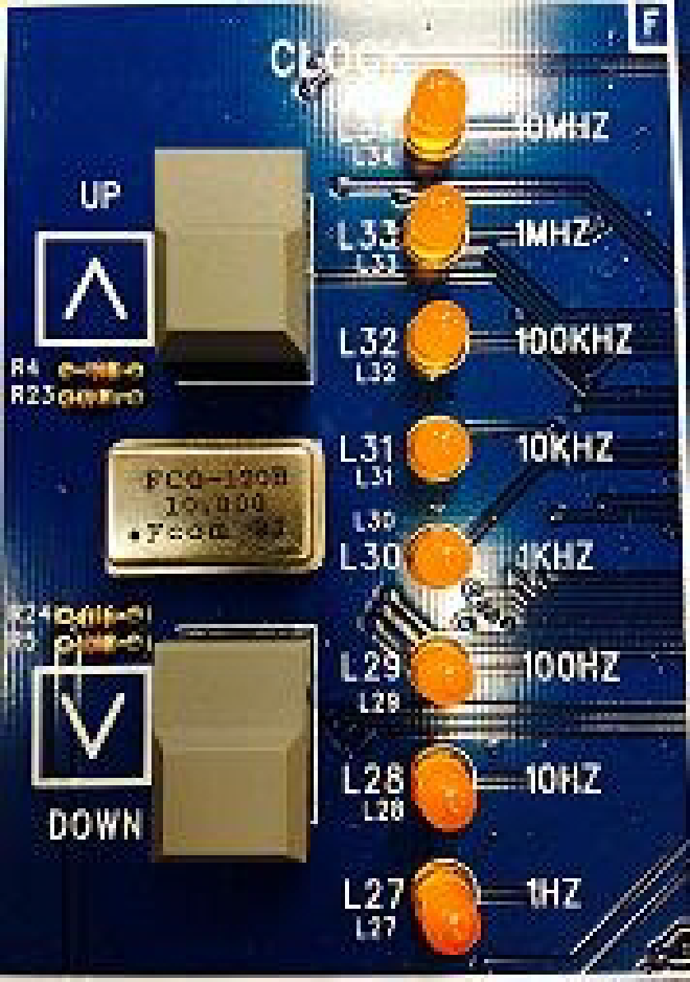

Clock

Slide 2
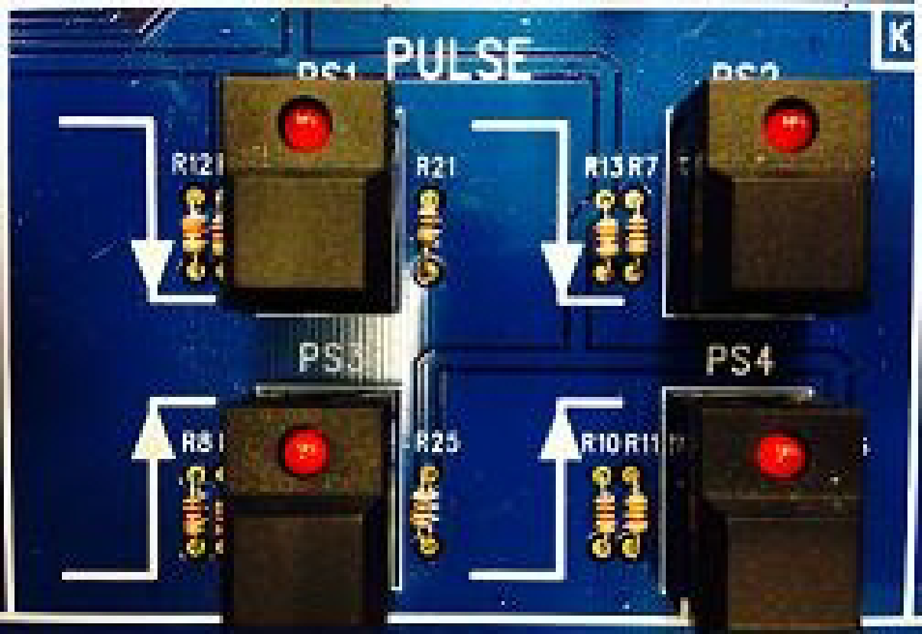
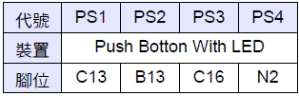
Reset

Slide 3
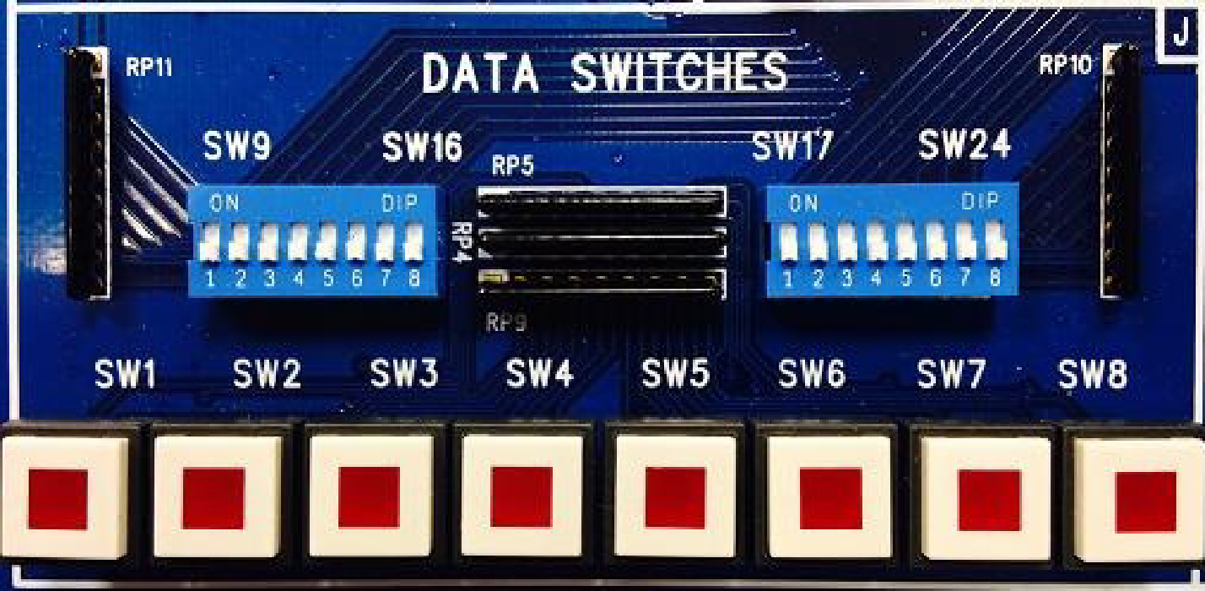
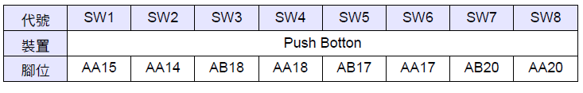
Data Switches

Slide 4
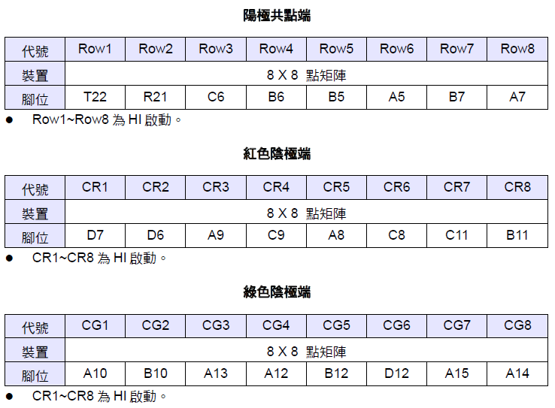
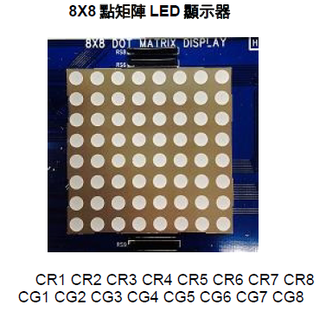
8x8 Dot Matrix Display
ROW1- ROW8 turn on when high(1)
Row1
Row2
Row3
Row4
Row5
Row6
Row7
Row8
CR1- CR8 turn on when high(1)
CG1- CG8 turn on when high(1)

Slide 5
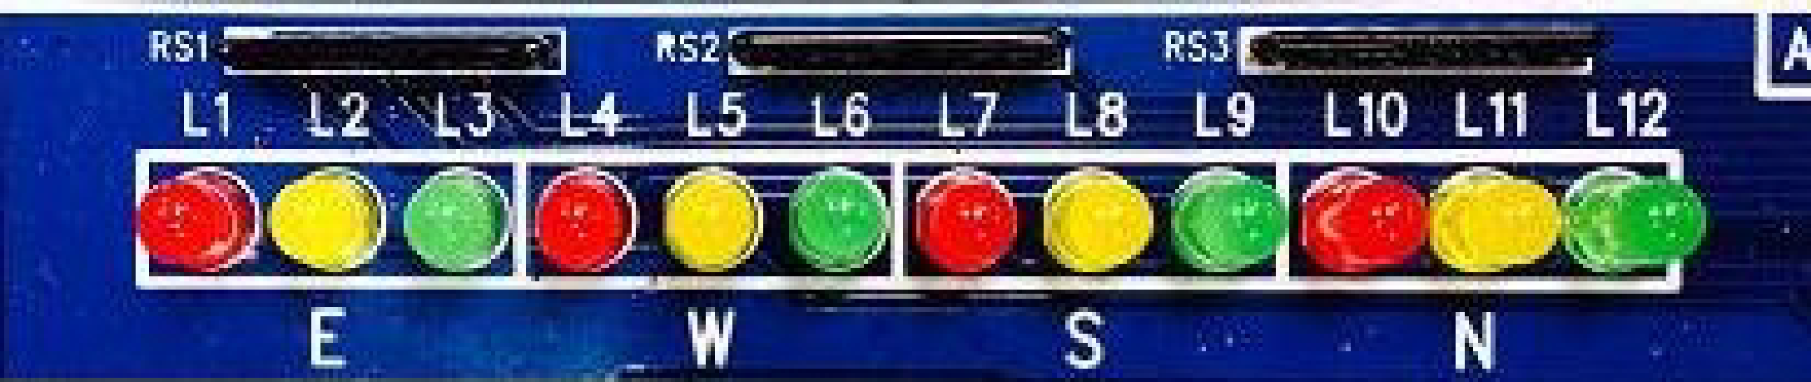
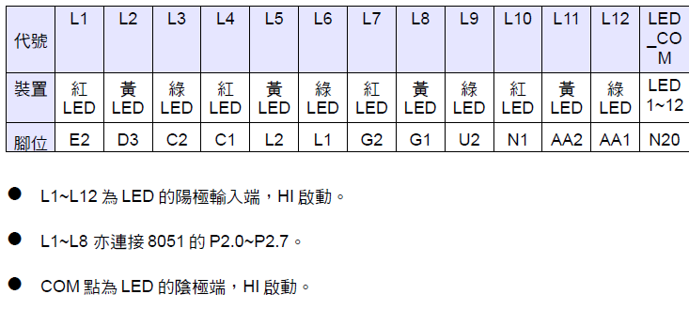
RGB LED

Slide 6
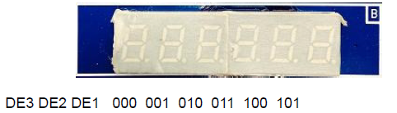
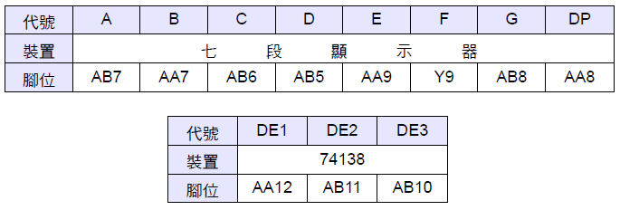
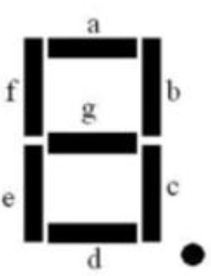
7 SEGMENT DISPLAY
DP

Slide 7
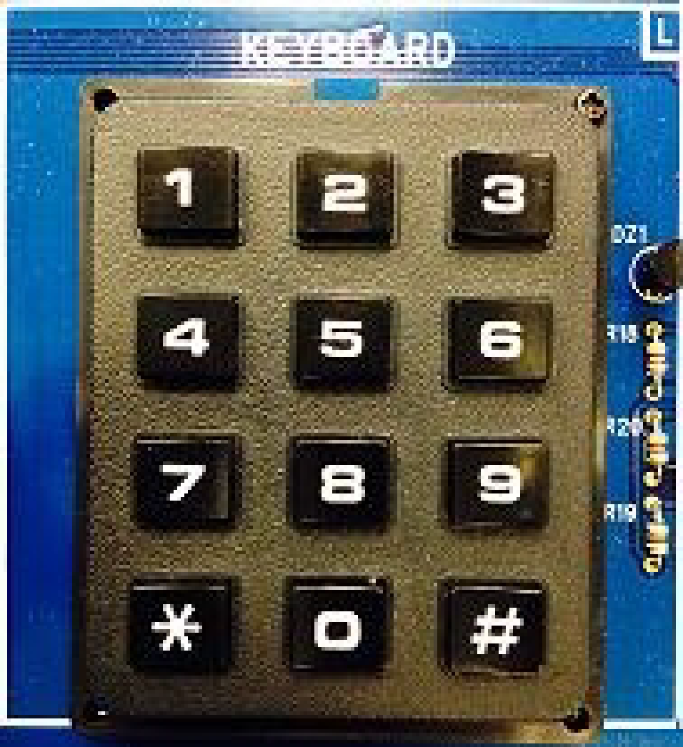
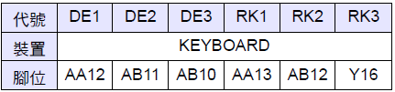
KEYBOARD
RK1 RK2 RK3
DE3 DE2 DE1
C1 000
C2 001
C3 010
C4 011

